Slide 1
ME308 Project – Team 36
Bus Route Optimization
Members
Sumeet Ranjan : 190040120
Aditya Chopra : 190020034
Rezeena Chinthamalla : 190100099
Thurkapally Manogna : 190100130

Slide 2
CONTENTS
MODELLING CAMPUS
PROBLEM STATEMENT
MODEL
MODELLING CITY TRANSPORT
PROBLEM STATEMENT
MODEL
UNCERTAINTY ANALYSIS

Slide 3
MODEL
As the first approach we try to model the bus routing problem for the campus, to transport the students from their respective residence to lecture hall.
This model incorporates bus capacity and time constrained vehicle problem.
The model optimises for the least operating cost for both operating cost and amortized servicing cost of the busses, giving us the least number of bus required to cover all the bus stops.

Slide 4
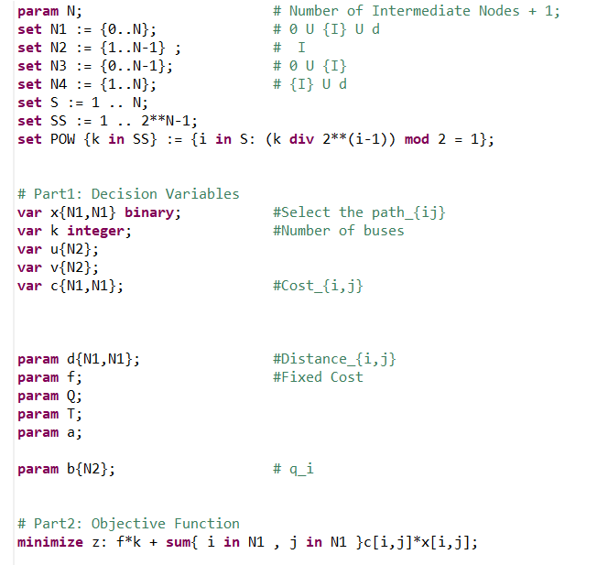
Parameters, Variables and Objective Function

Slide 5

Variables
$x_{ij}=\left\{\begin{aligned}1 if any bus traverses through i,j \\ 0 otherwise \end{aligned}\right.$
$k=number ofbuses$
$u_{i}=Total number of students picked just after leaving node i.$
$v_{i}=distance travelled by bus uptil node i.$

Slide 6

Parameters
$N=Number of intermediate nodes+1.$
{0} : origin ; {d}: dummy node.
I = set of intermediate nodes.
${Sets :N}_{1}=I∪\left\{0\right\}∪\left\{d\right\};{ N}_{2}=I ;N_{3}=\left\{0\right\}∪I ;N_{4}=I∪\{d\}$
$d_{ij}=distance between nodes i and j$
$f=amortized cost for each bus$
$Q=Upper bound on total capacity of each bus.$
$T=Upper bound on distance travlled by each bus.$
$b_{i}=number of students to be picked up at each node i$

Slide 7

Objective Function
$$minimise : f∗k +\sum_{i∈N_{1}}{\sum_{j∈N_{1}}{c_{ij}∗x_{ij}}}$$
The objective function is the total cost of travel and fixed amortized cost for k buses used. The aim of this formulation is to minimise the objective function.

Slide 8
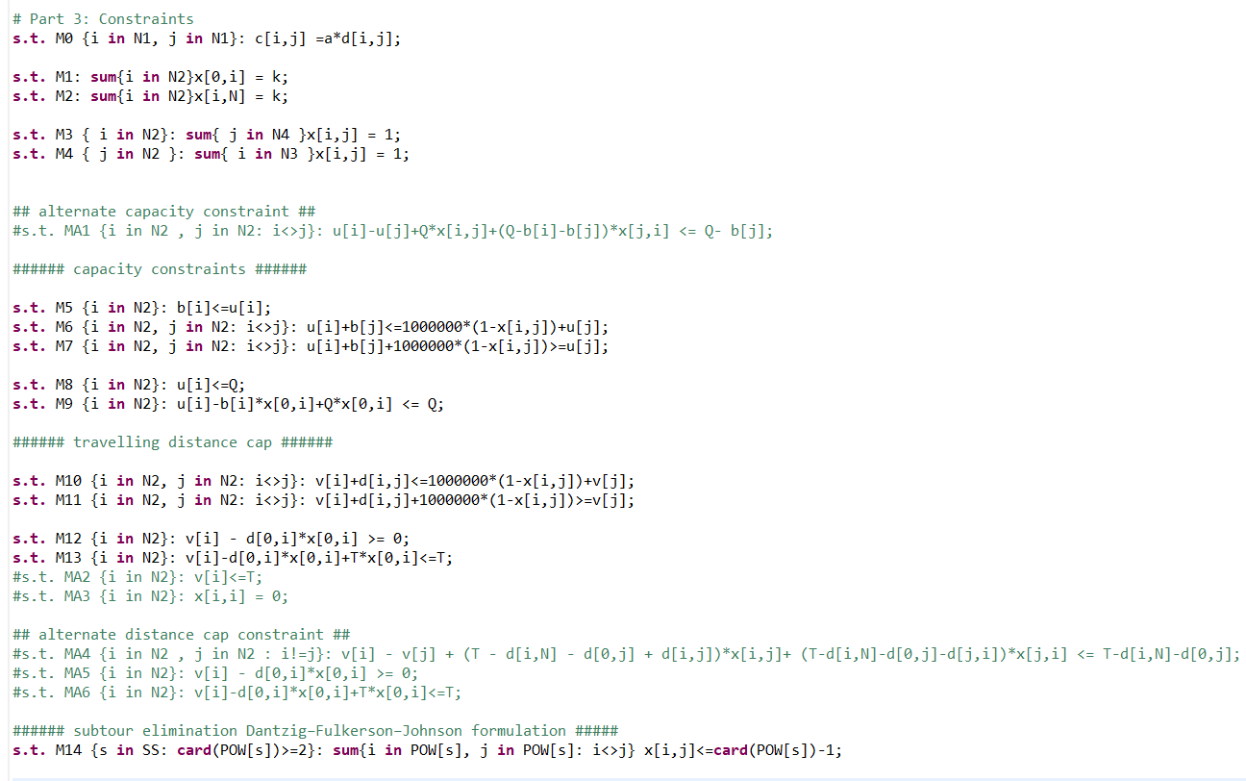
Constraints

Slide 9



Constraints
$$M0 : c_{ij}=a∗d_{ij } ∀ i,j∈N_{1}$$
Setting the cost matrix proportional to distance matrix.
$$M1 : \sum_{i∈N_{2}}{x_{0i}=k }$$
Sum of buses leaving the origin (o) is equal to number of buses.
$$M2 : \sum_{i∈N_{2}}{x_{id}=k }$$
Sum of buses entering the dummy node (d) is equal to number of buses.

Slide 10


$$M3 : \sum_{j∈N_{4}}{x_{ij}}=1 ; ∀i∈N_{2}$$
$$\text{Sum} \text{of} \text{buses} \text{leaving} \text{an} \text{intermediate} \text{node}\text{ = 1}\text{.}$$
$$M4 : \sum_{i∈N_{3}}{x_{ij}}=1 ; ∀j∈N_{2}$$
Sum of buses entering an intermediate node = 1.
$M5 :{ b}_{i}≤u_{i} ; ∀i∈N_{2}$
$$Total number of students picked up just after leaving node i is greater than or equal to number$$
$of students picked upt at node i.$

Slide 11
$$M6 : u_{i}+b_{j}≤1000000∗\left(1−x_{ij}\right)+u_{j} ; ∀i,j∈N_{2 } , i≠j$$
$M7 :$ $u_{i}+b_{j}+1000000∗\left(1−x_{ij}\right)≥ u_{j} ; ∀i,j∈N_{2}, i≠j$
$$Trivial for x_{ij}=0. For x_{ij}=1, M6 and M7 combine to give u_{i}+b_{j}=u_{j}$$
$$i.e. total number of students picked up till node i+ number of students at node j=$$
$$total number of students picked up till node j , as bus moves from i to j$$
$M8 :u_{i}≤Q ; ∀ i∈N_{2}$
$$Total number of students picked up just after leaving node i is less than or equal to$$
$maximum capacity possible$

Slide 12

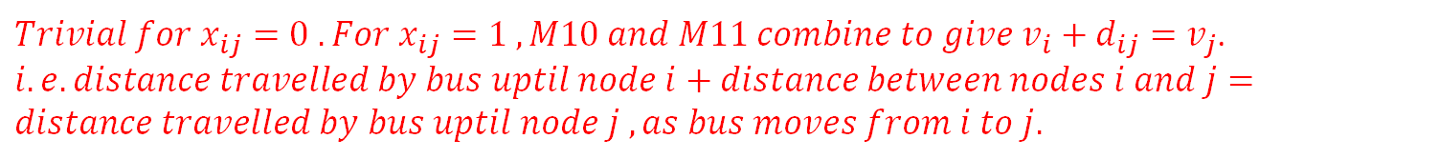

$M9 : u_{i}−b_{i}∗x_{0i}+Q∗x_{oi}≤Q ∀ i∈N_{2}$
$$Trivial for nodes for which x_{0i}=0. For x_{0i}=1;M9 and M5 combine to give b_{i}=u_{i}.$$
$$M10 :v_{i}+d_{ij}≤1000000∗\left(1−x_{ij}\right)+v_{j} ; ∀i,j∈N_{2 } , i≠j$$
$$M11 :v_{i}+d_{ij}+1000000∗\left(1−x_{ij}\right)≥v_{j} ; ∀i,j∈N_{2 } , i≠j$$
$Trivial for x_{ij}=0 . For x_{ij}=1 , M10 and M11 combine to give v_{i}+d_{ij}=v_{j}$.
$$i.e.distance travelled by bus uptil node i+distance between nodes i and j=$$
$$distance travelled by bus uptil node j , as bus moves from i to j.$$

Slide 13
$$M12 :v_{i}−d_{oi}∗x_{oi}≥0; ∀i∈N_{2}$$
$Trivial for x_{0i}=0. For x_{oi}=1;M12 and M13 combine to give v_{i}=d_{oi}.$
$$M13 :v_{i}−d_{oi}∗x_{oi}+T∗x_{oi}≤T ; ∀i∈N_{2}$$
$$For x_{oi}=0; v_{i} is limited by maximum distance that the bus can travel. For x_{0i}= 1,$$
$$M12 and M13 combine to give v_{i}=d_{oi}$$
$$M14 : \sum_{i}{\sum_{j}{x_{ij}}} ≤\left|POW\left(s\right)\right|−1 ;∀ s∈\left\{1,2,.. \left(2^{n}−1\right)\right\}, i,j∈POW\left(s\right) , i≠j,\left|POW\left(s\right)\right|≥2$$
$To ensure that cycles do not occur.$

Slide 14
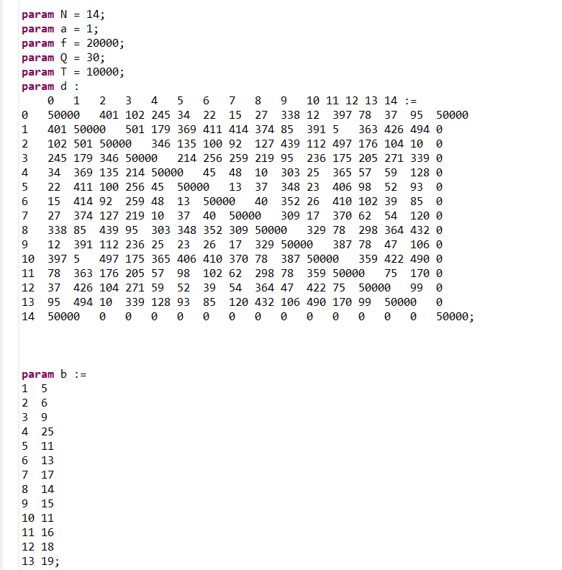
Data Set

Slide 15
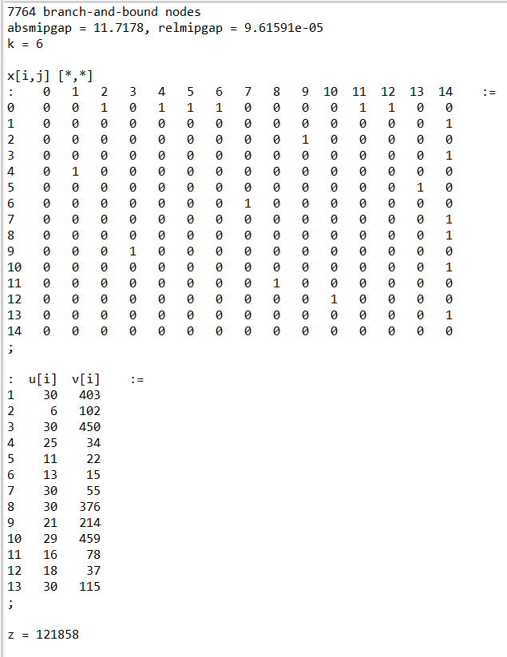
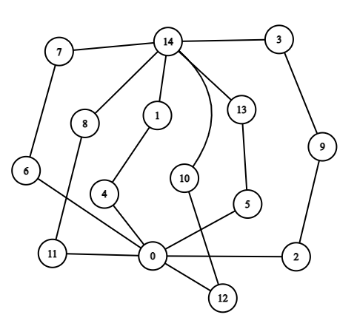
Results

Slide 16

Model 2
This model deals with the case of variable initial and final stations.
For each of the {R} routes, the initial and final stations are fixed.
Number of Passengers demanding to travel from node o to destination d are denoted as $D^{od}.$
Demand $D^{od}$ can make transfer at any node i, from one route to the other.
For such system, we need to specify the distance between nodes, initial and final stations for each route and demand od.

Slide 17
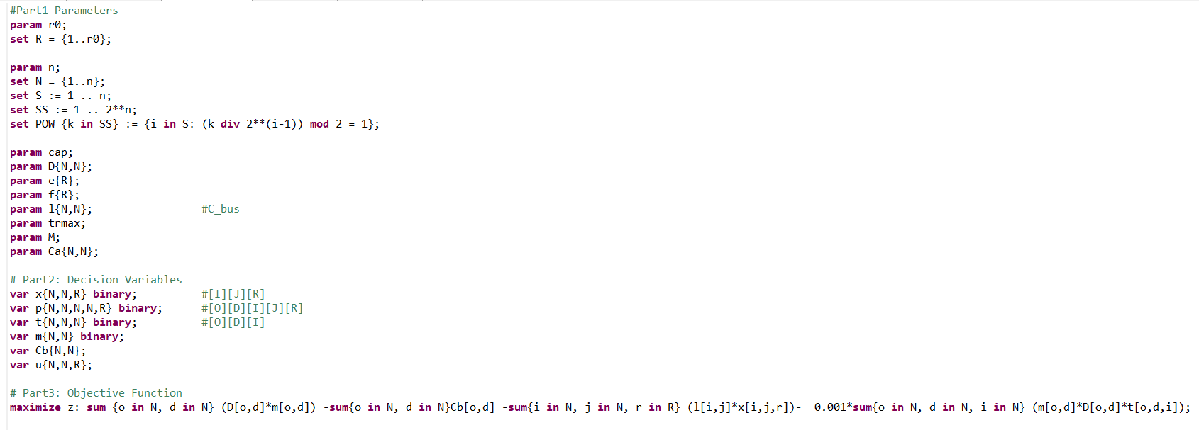
Parameters, Variables and Objective Function

Slide 18

Variables
$x_{ijr}=\left\{\begin{aligned}1 if route r passes through segment ij \\ 0 otherwise \end{aligned}\right.$
$p_{ijr}^{od}=\left\{\begin{aligned}1 if demand od uses segment ij on route r \\ 0 otherwise \end{aligned}\right.$
$t_{i}^{od}=\left\{\begin{aligned}1 if demand od stops at node i for transfer \\ 0 otherwise \end{aligned}\right.$
$m^{od}=\left\{\begin{aligned}1 if demand od uses bus for travelling \\ 0 otherwise \end{aligned}\right.$
$C_{b}^{od}=Cost for demand od, for using bus system.$
$u_{ijr}=Number of passengers travelling from node i to node j , using route r.$

Slide 19

Parameters
$r_{0} :Number of routes$
$n : Number of nodes$
$D^{od}:Demand for travelling from node o to d.$
$e\left(r\right):initial station for route r.$
$f\left(r\right):final station for route r.$
$l_{ij}: length between node i and j.$
$tr_{max}:maximum number of transfers desired.$
$M:constant with high value$
$cap: maximum capacity the bus can fill.$

Slide 20

Sets
$R=\{1,2,3…r_{0}\}$
$N=\{1,2,3…n\}$
$S=\{1,2,…n\}$
$SS=\{1,2, …2^{n}\}$
POW = power set of S

Slide 21
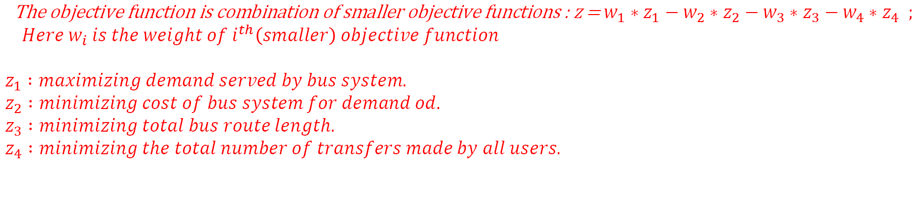

Objective Function
$$maximize : \sum_{o}{\sum_{d}{D^{od}m^{od}}}−\sum_{o}{\sum_{d}{C_{b}^{od}}}−\sum_{i}{\sum_{j}{\sum_{r}{l_{ij}∗x_{ijr}}}}−0.001\sum_{o}{\sum_{d}{\sum_{i}{m^{od}∗D^{od}∗t_{i}^{od}}}}$$
$$\text{The} \text{objective} \text{function} \text{is} \text{combination} \text{of} \text{smaller} \text{objective} \text{functions}\text{ : }\text{z}\text{ = }{w_{1}∗z}_{1}−{w_{2}∗z}_{2}−{w_{3}∗z}_{3}−w_{4}∗z_{4} ;$$
$$Here w_{i} is the weight of i^{th}\left(smaller\right) objective function$$
$$z_{1} :maximizing demand served by bus system.$$
$$z_{2} :minimizing cost of bus system for demand od.$$
$$z_{3} :minimizing total bus route length.$$
$$z_{4} :minimizing the total number of transfers made by all users.$$

Slide 22
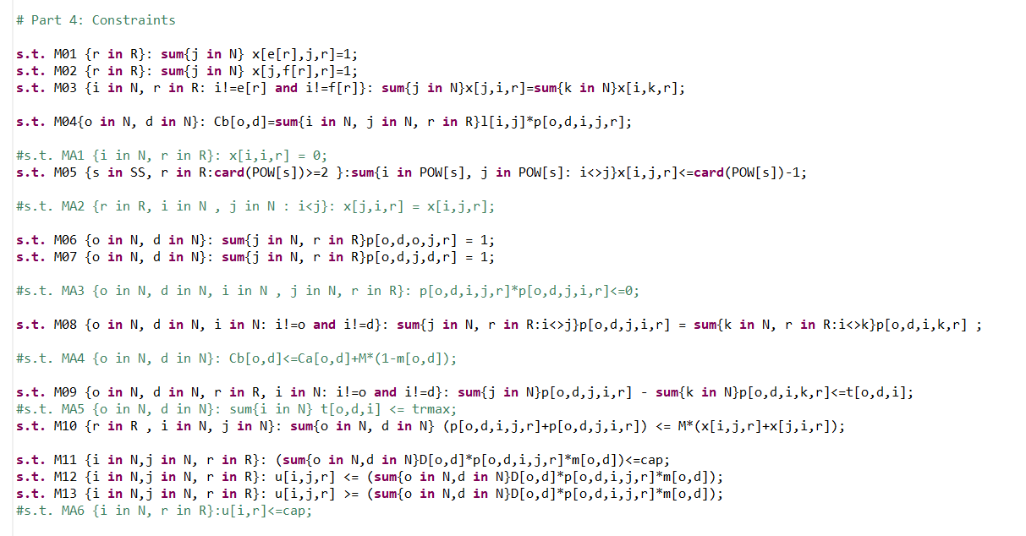
Constraints

Slide 23



Constraints
$M1 : \sum_{j}{x_{e\left(r\right)jr}= 1} ; ∀ r$
For each route ‘r’ , number of buses leaving e(r) is 1.
$$M2 :\sum_{j}{x_{jf(r)r}= 1 ; ∀ r }$$
For each route ‘r’ , number of buses entering f(r) is 1.
$$M3 :\sum_{j}{x_{jir}=\sum_{k}{x_{ikr} }} ; ∀r ,i≠e(r)≠f(r)$$
For each node i (other than e(r) and f(r)), : a segment of route r arrives at node i, then a segment must also leave from it.

Slide 24


$$M4 :{ C}_{b}^{od}= \sum_{i}{\sum_{j}{\sum_{r}{l_{ij}∗p_{ijr}^{od}}}} ;∀ o,d$$
$$Cost of bus for demand od is proportinal to total length travelled by passenger o to d , via all routes possible$$
$$M5 :\sum_{i∈POW(s)}{\sum_{j∈POW(s)}{x_{ijr}}}≤\left|POW\left(s\right)\right|−1 ; ∀r, s∈SS ;\left|POW\left(s\right)\right|≥2$$
To ensure that no cycles will occur, we use this constraint.
$$M6: \sum_{j}{\sum_{r}{p_{ojr}^{od}}}=1 ; ∀ o,d$$
$$\text{From} \text{the} \text{trip} \text{origin} \text{o} \text{of} \text{each} \text{demand} \text{od}\text{, }\text{the} \text{demand} \text{should} move from o to j via 1 route.$$

Slide 25




$$M7 :\sum_{j}{\sum_{r}{p_{jdr}^{od}}}=1 ; ∀ o,d$$
Towards the final destination trip d of each demand od, the demand enters d via 1 route.
$$M8 :\sum_{j}{\sum_{r}{p_{jir}^{od}}}=\sum_{k}{\sum_{r}{p_{ikr}^{od}}} ∀o,d, i≠o≠d$$
$$i≠j i≠k$$
In nodes i, different from the trip origin or destination of each demand od, if a traveler arrives at that node, he must continue his journey to another node.
$$M9: \sum_{j}{p_{jir}^{od}} −\sum_{k}{p_{ikr}^{od}} ≤t_{i}^{od} ∀o,d,r, i≠o≠d$$
$Constraint to track transfer at each node i, for demand od.$

Slide 26


$$M10 :\sum_{o}{\sum_{d}{p_{ijr}^{od}+p_{jir}^{od} }}≤M∗\left(x_{ijr}+x_{jir}\right) ; ∀r,i,j$$
$$Trivial for either or both x_{ijr} or x_{jir}=1 . For x_{ijr}=x_{jir}=0, for every demand od, p_{ijr}^{od}=p_{jir}^{od}=0$$
$$M11 :{ u}_{ijr} ≤cap; ∀r,i,j$$
The number of passengers in the bus is bounded by the maximum capacity of bus.
$$M12 :u_{ijr}=\sum_{o}{\sum_{d}{D^{od}∗p_{ijr}^{od}∗m^{od}}} ; ∀r,i,j$$
$$Number of passengers travelling from node i to node j , using route r.$$

Slide 27
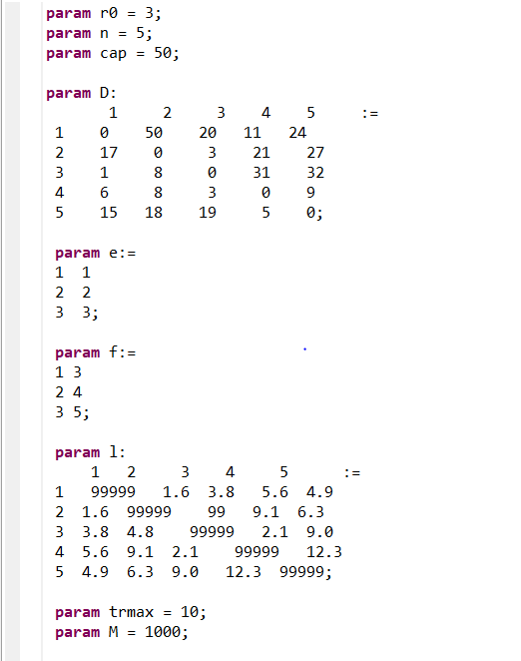
Data set

Slide 28

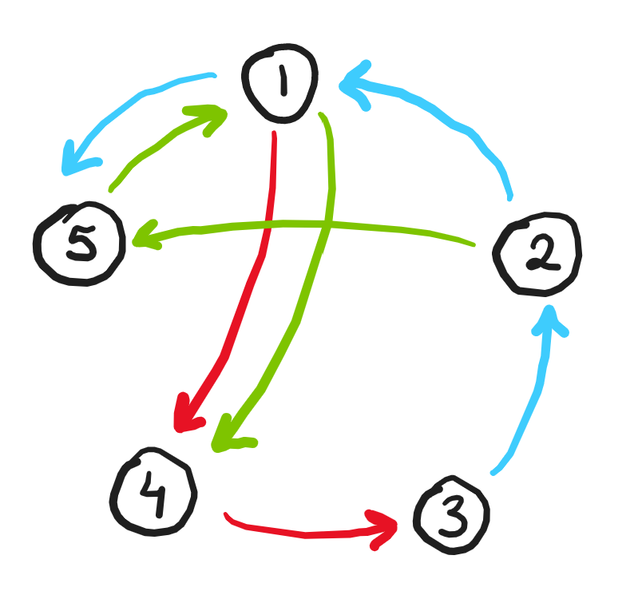
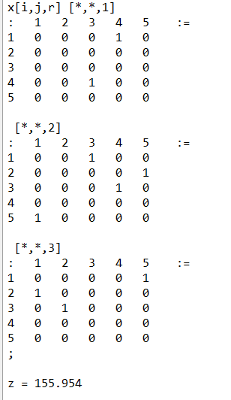
Results

Slide 29
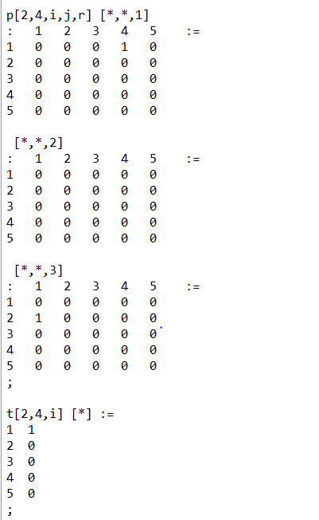
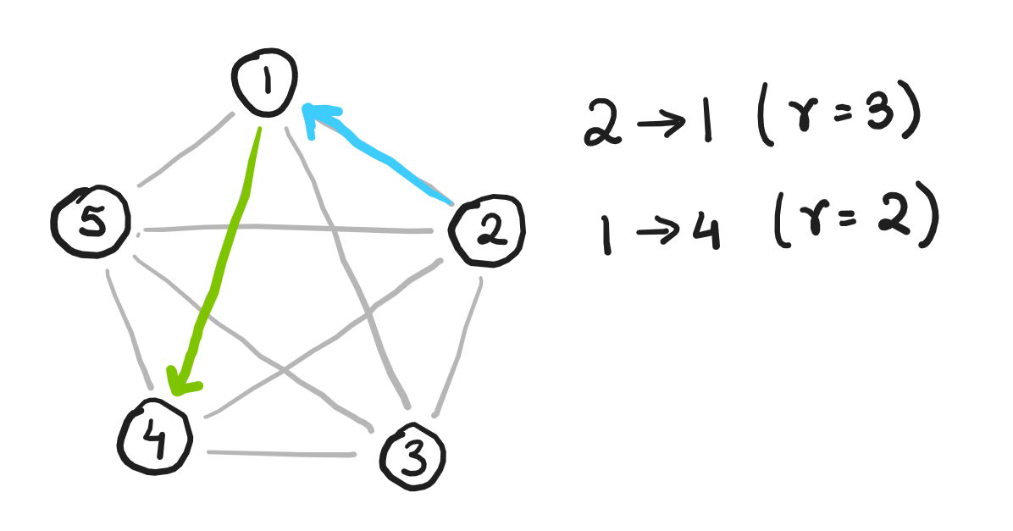
esults

Slide 30
Model robustness
In order to access the robustness of the model, we use greedy method to simulate the model in real world.
The demand is sampled from gaussian distribution with mean as the demand used during optimization and fixed standard deviation.
We get the fraction of total passengers served over the entire demand.
The average of the score gives a good idea about the robustness of the model.

Slide 31
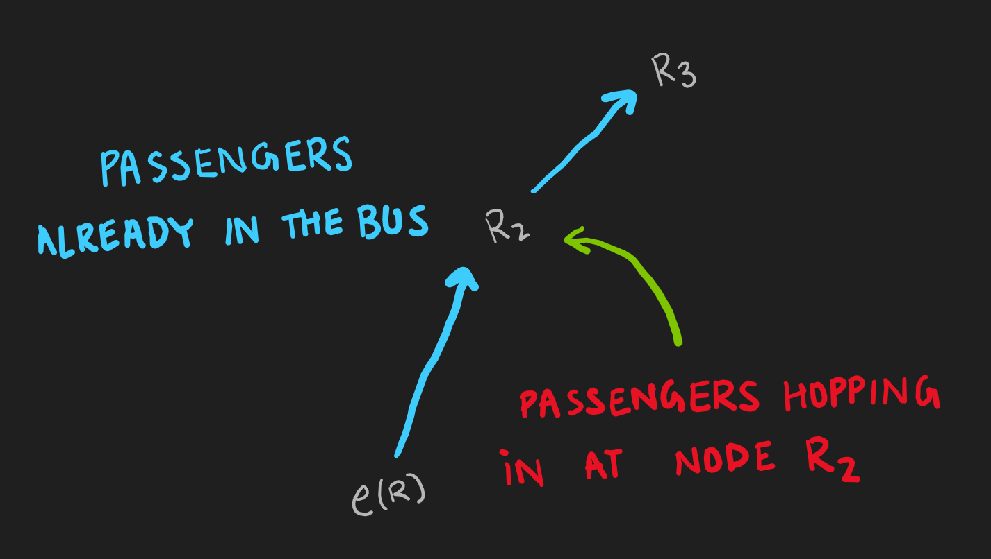
We use greedy method to simulate the model.
The number of passengers who start at some node i who get to travel in the bus is equal to
capacity of bus – passengers already in the bus
So traversing through the route plied by the bus. We get the fraction of passengers who get to travel in bus.

Slide 32
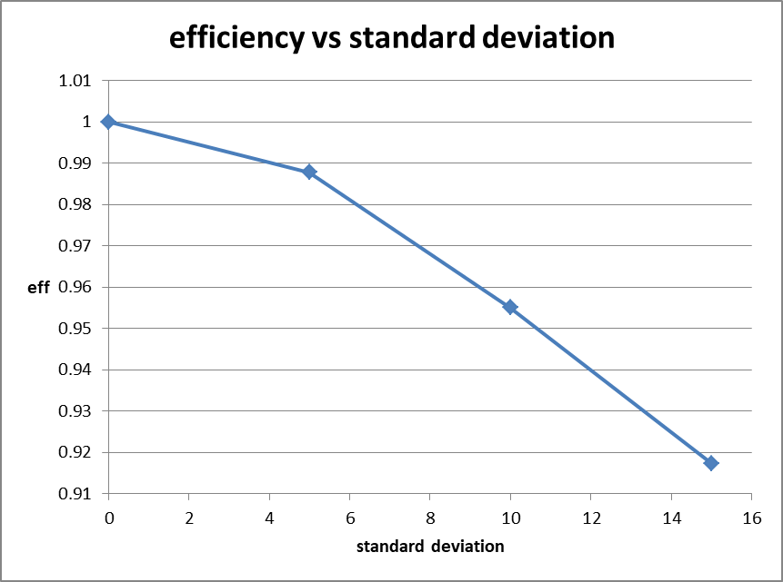
results
Using greedy method, the fraction of passengers that can get on the bus depends on number of passenger already on the bus and its capacity.
We see pretty high fraction of passengers served.
The fraction of demand served reduces as the uncertainty in demand increase

Slide 33
Results
We observe that the optimised model depends on the weights assigned to each term in the objective function.
Changing weights can aggressively
Minimise the number of bus changes passengers have to make.
Minimise the average cost of travel for passengers.
Maximise the number of passengers served
Minimise the operating cost.

Slide 34
Model
https://github.com/sumeet-ranjan/bus-route-optimization

